Slide 1
Options Portfolio Selection
Team John: Heeth, May, Brian, Kai, Yorkinoy

Slide 2
Introduction
The paper examined the performance of mean-variance efficient portfolios spanning the period 1996 to 2020. These portfolios included monthly options with strikes from S&P 500, Nasdaq 100, and Dow Jones indexes. The authors introduces a naive technique in the study for selecting option portfolios that optimize the Sharpe ratio, considering position limits, and distinguishing between buying and selling prices as well as shorting and longing prices. This approach bears similarity to portfolio weight regularization, a traditional technique in portfolio optimization designed to address issues associates with extreme asset weights in portfolio.

Slide 3
Paper’s Methodology
Monthly process based on:
Forecasted volatility
Calculated Returns / Covariance
Risk - Aversion Factor
Maximize Sharpe Ratio with position limits
Portfolio weight regularization to mitigate errors and price disparities

Slide 4
Methodology Comparison
Paper’s
Team John’s
Data Range: 1996 - 2020
Monthly weights rebalancing
Volatility: GARCH method to factor volatility
Estimation of μ: Parameterized NASDAQ estimates using normal distributions
Data Range: 2018 - 2022
Static weights
Volatility: Tradable strike range as spread proxy
Estimation of μ: Picking median strike price

Slide 5
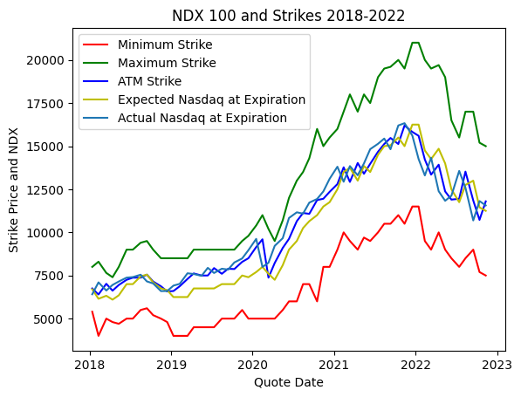
Data Clean-up Process

Slide 6
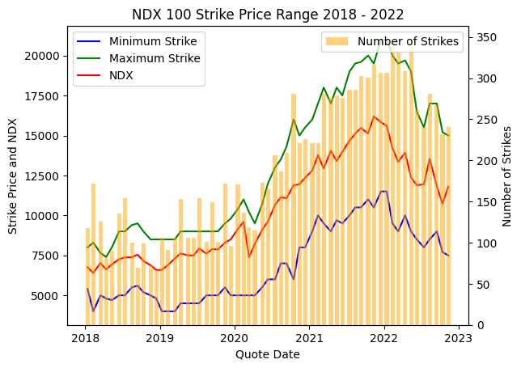
Data Clean-up Process
Filter second Fridays
Make sure there’s no bid > ask
Calculate spot price using put–call parity

Slide 7
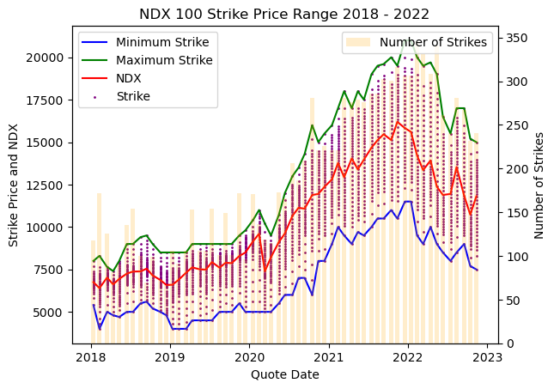
Data Clean-up Process
Use median as midpoint
Sample 35 strike prices in equal proportion
Calculate each PNL

Slide 8
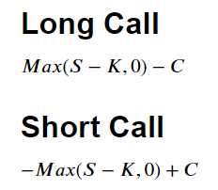
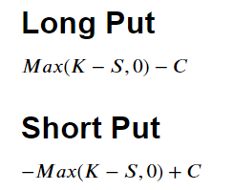
Data Clean-up Process
S : NASDAQ 100
K : Strike
C : Option Premium

Slide 9



Markowitz’s Mean-Variance Analysis
Idea: construct a portfolio of multiple assets that will maximize return for a given level of risk.
Expected return:
Risk:

Slide 10
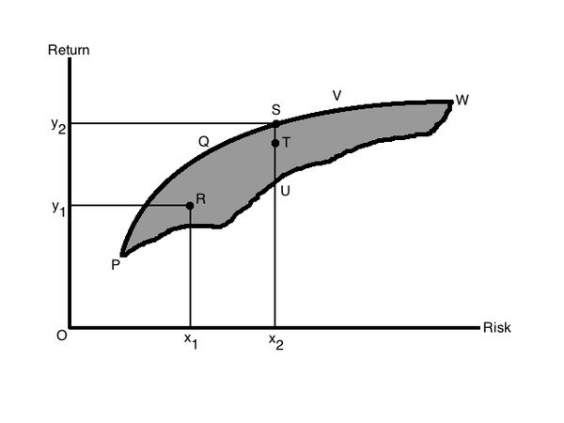
Markowitz’s Mean-Variance Analysis
Limitations
Sensitive to input adjustments
Solution can be long positions + large short positions (transaction costs, margin requirements)
Information intractable and no room for ‘views’

Slide 11



Why Mean-Variance Optimization with Position Limit?
Objective function:
limited confidence in estimated expected return
Portfolio(w) =
At , it achieves minimum =
Upper bound:
Discourages portfolios with large differences in the weights of nearby contracts.

Slide 12
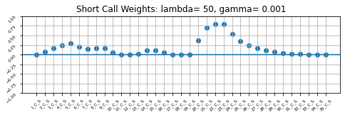
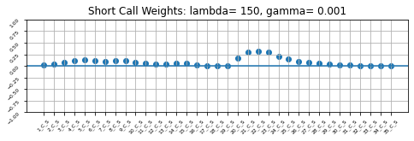

Mean-Variance Optimization with Position Limit
Lambda = 50
Lambda = 150
Lambda = 250

Slide 13
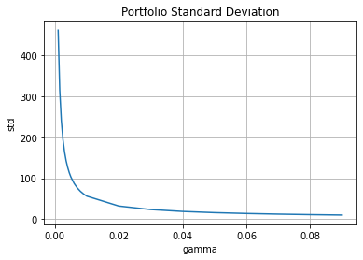
Mean-Variance Optimization with Position Limit

Slide 14
Results

Slide 15
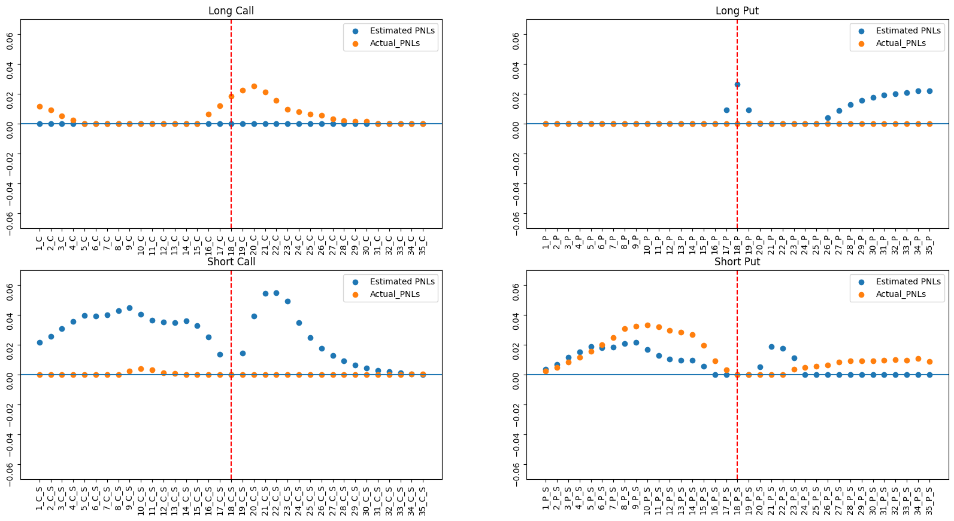

Slide 16
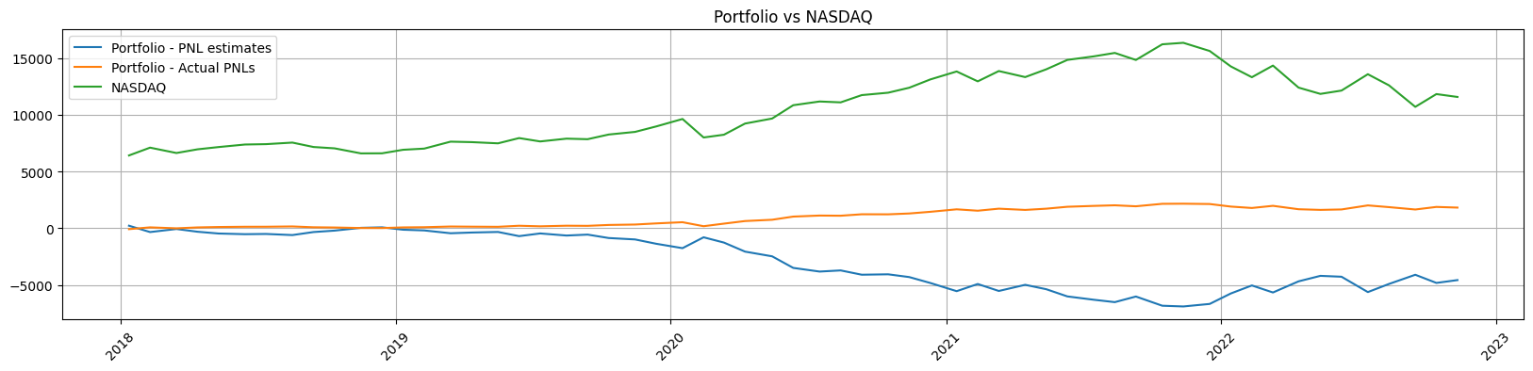
PNL outcomes

Slide 17
Gamma and Lambda effects on portfolio outcomes
γ / λ | 1 | 10 | 100 | 1000 | 10000
1 | 1.33 | 1.13 | 1.21 | 1.07 | 1.04 | 0.968 | 0.73 | 0.753 | 0.35 | 0.44
0.1 | 12.1 | 10.7 | 10.4 | 9.68 | 7.32 | 7.53 | 3.45 | 4.43 | 1.03 | 2.05
0.01 | 104 | 97.9 | 73.2 | 75.3 | 34.5 | 44.32 | 10.3 | 20.5 | 3.08 | 13.6
0.001 | 732 | 752 | 344.8 |443.2 | 103.2 |205.3 | 30.8 | 136.2 | 12.6 | 80.4
0.0001 | 3448 | 4432 | 1032 | 2053 | 308.8 | 1362 | 125.6 |803.5 | 24.9 | 170.3

Slide 18
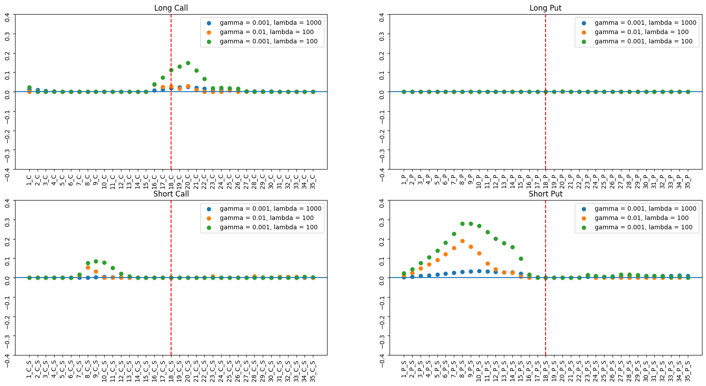

Slide 19
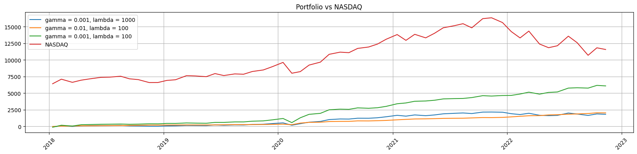

Slide 20
Questions?

